Slide 1


M.Tech Program
Advanced Industry Integrated Programs
Jointly offered by University and LTIMindTree
Review II
Project Title
ClusterMind: Multi-Agent GPU Workload Assurance and Recovery Platform
Team Member
Dhayanidhi R S
Knowledge partner | Implementation partner
Notes:
ClusterMind detects GPU degradation, explains its workload impact, identifies the probable cause, and recommends a safe recovery action.

Slide 2
ClusterMind: Multi-Agent GPU Workload Assurance and Recovery Platform
Introduction
Background
  Modern AI training and inference depend on costly, long-running GPU clusters where thermal, memory, power, hardware and interconnect issues can reduce throughput, interrupt workloads and waste compute capacity.
  Existing monitoring platforms expose these failures as technical metrics, but understanding the workload impact, probable cause, and correct recovery action still requires expert manual analysis.
Proposed System
  ClusterMind is an end-to-end GPU assurance platform that collects telemetry, detects anomalous behavior, evaluates workload impact, and coordinates four specialized agents to diagnose the probable cause and recommend recovery.
Notes:
ClusterMind converts raw GPU telemetry into an understandable incident explanation and a controlled recovery recommendation.

Slide 3
ClusterMind: Multi-Agent GPU Workload Assurance and Recovery Platform
Objectives
Detect abnormal GPU behavior from correlated telemetry.
Measure the impact on training and inference workloads.
Identify probable root causes using evidence and runbooks.
Generate safe, checkpoint-aware recovery recommendations.
Keep infrastructure-changing actions behind human approval.
Provide end-to-end monitoring, tracing, and operator visibility.
Notes:
The objective is not only anomaly detection. The system must explain what happened, why it matters, and what should be done safely.

Slide 4
ClusterMind: Multi-Agent GPU Workload Assurance and Recovery Platform
Module name
GPU Telemetry and Simulation
Generates correlated GPU, node, workload, and incident telemetry for a 40-GPU synthetic cluster.
Anomaly Detection
Uses Isolation Forest and deterministic hardware rules to identify candidate GPU anomalies.
Multi-Agent Intelligence
Coordinates Telemetry, Workload Impact, Root Cause, and Recovery Agents through LangGraph.
Human Approval and Recovery
Presents evidence-backed recovery plans before any migration, restart, or quarantine action.
Operations and Observability
Combines Streamlit, Grafana, InfluxDB, Prometheus, OpenTelemetry, Jaeger, Redis, Celery, and ntfy.
Notes:
Each module has one clear responsibility, allowing the platform to remain modular, testable, and replaceable.

Slide 5
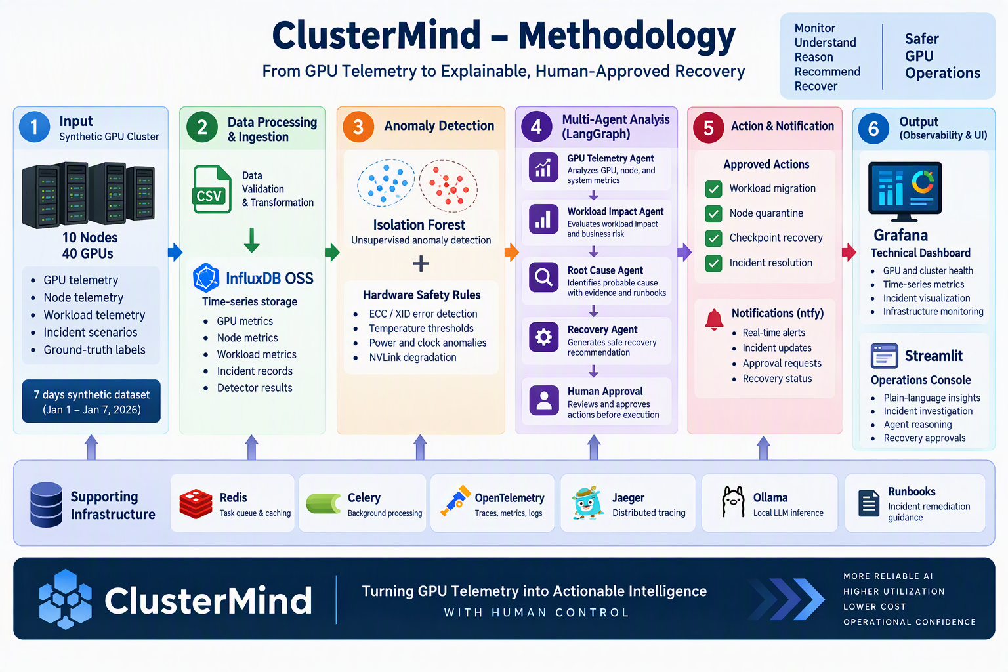
ClusterMind: Multi-Agent GPU Workload Assurance and Recovery Platform
Methodology / Modeling Plan
Notes:
The methodology separates deterministic detection, agent reasoning, and human authorization rather than allowing one model to control the entire process.

Slide 6
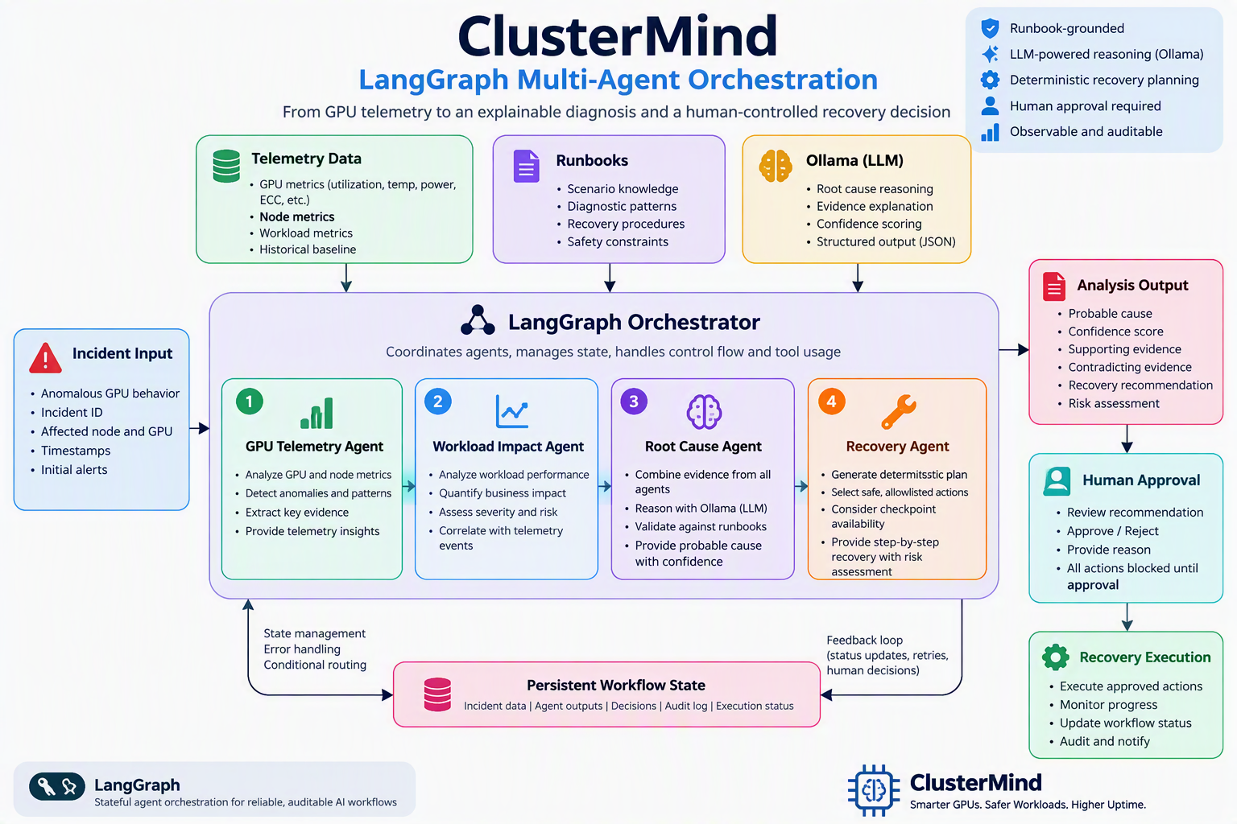
ClusterMind: Multi-Agent GPU Workload Assurance and Recovery Platform
Notes:
The methodology separates deterministic detection, agent reasoning, and human authorization rather than allowing one model to control the entire process.

Slide 7
ClusterMind: Multi-Agent GPU Workload Assurance and Recovery Platform
Data preprocessing & EDA
Preprocessing
Validated schemas, timestamps, identifiers and required fields
Removed invalid, non-finite and out-of-range values
Normalized timestamps and maintained incident windows
Preserved incident labels for evaluation while preventing label leakage during detection
EDA Findings
Reliability incidents produce correlated hardware and workload changes.
Thermal and power incidents reduce clocks and useful throughput.
Memory and link incidents increase latency and error rates.
Healthy high utilization differs from harmful anomalies through workload productivity.
Workload context is necessary to reduce false positives.

Slide 8
ClusterMind: Multi-Agent GPU Workload Assurance and Recovery Platform
Approach/Algorithms/Tools
Data Layer: Synthetic GPU cluster, workload telemetry, incident labels, InfluxDB OSS
Detection Layer: StandardScaler, Isolation Forest, ECC/XID/temperature safety overrides
Agent Layer: LangGraph with Telemetry, Workload Impact, Root Cause, Recovery Agents
Reasoning Layer: Local Ollama model with structured prompts, runbooks, and evidence
Application Layer: FastAPI, Streamlit operations console, Grafana technical dashboards
Execution Layer: Redis, Celery, checkpoint-aware recovery, human approval, ntfy
Observability Layer: Prometheus, OpenTelemetry, Jaeger, structured application metrics
Notes:
The entire implementation is open-source and locally deployable through an isolated Docker Compose stack.

Slide 9
ClusterMind: Multi-Agent GPU Workload Assurance and Recovery Platform
Project plan / Milestone progress
Phase | Project Milestone | Status at Review 2
Phase 1 | Problem identification and architecture planning | Completed
Phase 2 | Synthetic GPU, node and workload telemetry generation with labelled incident scenarios | Completed
Phase 3 | Data validation, preprocessing, exploratory data analysis and feature engineering | Completed
Phase 4 | Isolation Forest model training, anomaly scoring and incident detection | Completed

Slide 10
ClusterMind: Multi-Agent GPU Workload Assurance and Recovery Platform
Project plan / Milestone progress
Phase | Project Milestone | Status at Review 2
Phase 5 | Incident evidence collection and correlation of GPU, node and workload signals | Completed
Phase 6 | Multi-agent workflow for GPU analysis, workload impact, root cause and recovery planning | Completed
Phase 7 | LangGraph orchestration and explainable end-to-end incident analysis | In Progress
Phase 8 | Human approval workflow and recovery recommendation interface | Planned

Slide 11
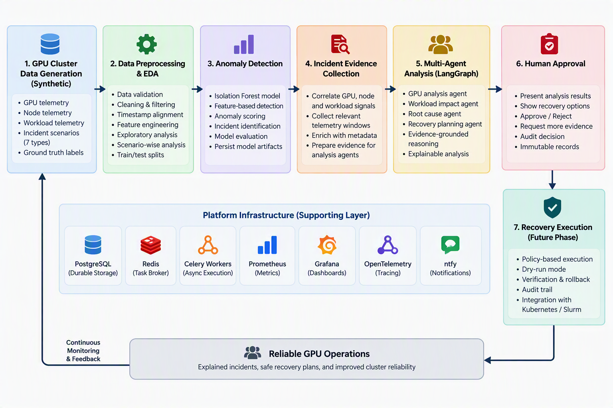
ClusterMind: Multi-Agent GPU Workload Assurance and Recovery Platform
Pipeline structure

